Slide 1
Project Presentation of Co-Op Project at Industry (Module-1)
On
Identification of Slow Learners Using Machine Learning: A Comparative Analysis of Classification Algorithms
Bahaar Sharma
2210990209
Supervised By
Dr. Gurpreet Singh, Department of CSE
Chitkara University
Department of Computer Science and Engineering,
Chitkara University, Punjab

Slide 2

Introduction & Objective
Background
Objective
• Students struggle silently — data exists in gradebooks and LMS logs, but nobody looks until it's too late.
• Instructors managing hundreds of students cannot manually track individual performance trends.
• Existing research predicts GPA brackets, not the binary question counselors face: does this student need help?
• Build a reliable, explainable early-warning system to identify slow learners using routine academic data.
• Compare 6 ML classifiers across 4 algorithmic families with rigorous evaluation.
• Use SHAP explanations to make predictions transparent and actionable for teachers.
• Determine the minimum data needed via ablation study.
2

Slide 3

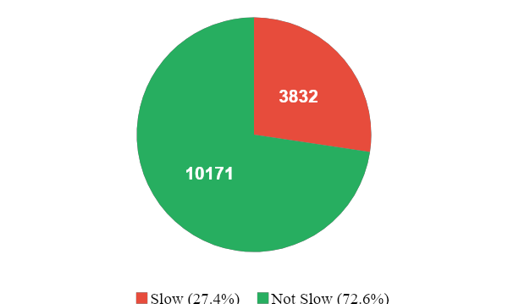
Dataset & Methodology
Dataset: Kaggle Student Performance
14,003 student records, 16 columns, no missing values
Binary label: Slow Learner (27.4%) vs Not Slow (72.6%)
80/20 stratified split, StandardScaler on training data
Features: Academic, Behavioral, Psychological, Demographic, Technology
Raw Data (14,003)
Preprocess & Scale
Binary Label Creation
6 Classifiers (Grid Search)
SHAP Explain
Intervention Alerts
Classification Algorithms Evaluated
Logistic Regression | Decision Tree | Random Forest (tuned) | SVM (tuned) | KNN | Gradient Boosting (tuned)
3

Slide 4
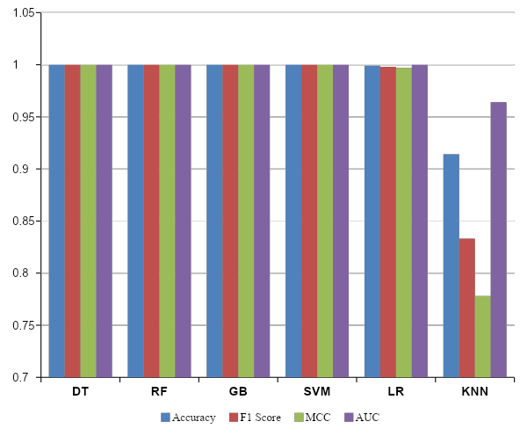
Key Findings: Model Performance
Key Takeaways
✓ 4 models achieved perfect scores (DT, RF, SVM, GB)
✓ LR missed only 3 of 766 slow learners
✗ KNN weakest at 91.4% — treats all features equally
Statistical Tests
• McNemar RF vs KNN: χ²=239, p<0.001 (sig.)
• RF vs LR: p=0.248 (not significant — tied)
• RF vs DT/SVM/GB: identical predictions
Training Speed
• DT: 4ms vs SVM: 3.5s
• 1000x faster, same accuracy
Conclusion: Tree-based models (DT, RF, GB) and SVM deliver peak performance, with DT offering a significant speed advantage.
4

Slide 5
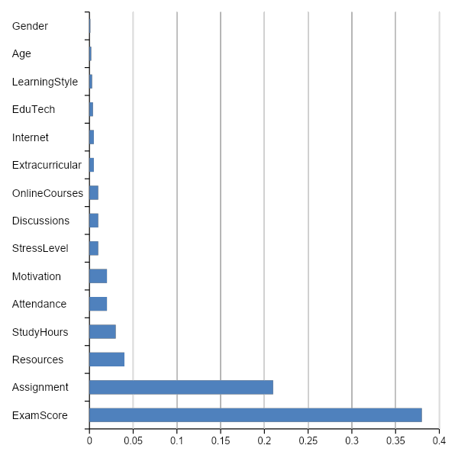
SHAP Analysis & Feature Importance
What SHAP Reveals
ExamScore is the dominant predictor — low scores strongly push toward 'slow learner'
AssignmentCompletion is the 2nd strongest signal
Demographics (Gender, Age) → near-zero contribution — model is fair
Stress, motivation, tech access → essentially noise
Example: Student Ravi
Exam avg = 44/100 → SHAP +0.38
Homework = 58% → SHAP +0.21
Counselor insight: content-understanding problem, not attendance or motivation issue
SHAP values provide local explainability, revealing why individual students are flagged as slow learners

Slide 6
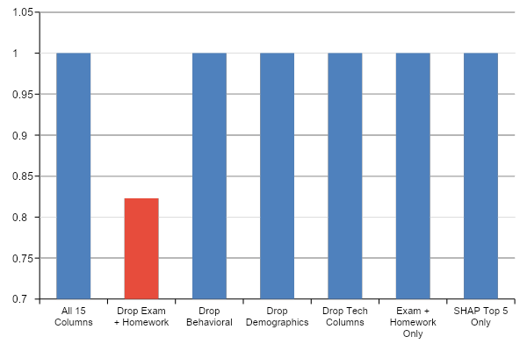
Ablation Study: What Data Do You Really Need?
Key Finding
Just 2 columns achieve the SAME perfect result as all 15!
ExamScore + AssignmentCompletion
Removing them is the ONLY thing that drops F1 (to 0.823)
A working early-warning system needs nothing more than the two numbers already in every gradebook.
6

Slide 7
Conclusion & Future Scope
Conclusion
4 of 6 classifiers achieved perfect test-set separation on 14,003 student records.
SHAP identified ExamScore and AssignmentCompletion as the only features that matter.
Ablation confirmed: just 2 columns replicate the full 15-column pipeline's performance.
Decision Tree recommended: 4ms training, perfect accuracy, fully interpretable.
Model is algorithmically fair — Gender and Age have near-zero influence.
Limitations
Single dataset source — generalizability to other institutions unknown.
No missing values — unrealistic for real-world gradebooks.
Binary framing erases spectrum between 'slightly behind' and 'completely lost'.
Future Scope
Temporal prediction — flag students at 25%, 50%, 75% of course completion.
Multi-institutional validation across diverse universities and curricula.
Incorporate qualitative signals — teacher notes, peer observations, LMS patterns.
Developing a robust, fair, and efficient early-warning system for identifying at-risk students.
7

Slide 8
References
[1] S. K. Malik, "Slow learners: Their psychology and educational programmes," Int. J. Educ. Psychol. Res., 2012.
[3] C. Romero & S. Ventura, "EDM and learning analytics: An updated survey," WIREs, 2020.
[5] C. Romero & S. Ventura, "EDM: A review of the state of the art," IEEE Trans., 2010.
[8] M. Hussain et al., "Student engagement predictions in e-learning," Comput. Intell. Neurosci., 2018.
[9] H. Waheed et al., "Predicting academic performance using deep learning," Comput. Hum. Behav., 2020.
[10] P. Kaur et al., "Classification to predict slow learners in education," Procedia CS, 2015.
[12] A. Shamim, "Student performance and learning style dataset," Kaggle, 2024.
[15] M. Adnan et al., "Predicting at-risk students at different course percentages," IEEE Access, 2021.
[18] S. M. Lundberg & S.-I. Lee, "A unified approach to interpreting model predictions," NeurIPS, 2017.
Thank You!
Bahaar Sharma | 2210990209 | bahaar209.be22@chitkara.edu.in
8

